Slide 1


Again, sorry for having to cut the demos and walk through the presentation a little faster than I had planned.
I will make videos of my demos as soon as I am able to.
I will also make a blogpost soon about Cond.Access hardening (you guys and girls were the first people I showed this too, but I forgot to mention that little fun-fact). 😱
“Soon” I will also make a follow up blogpost on passkeys, and the Powershell script for MFA adoption (slide 20)
I will try to get this done during August, but no promises 😉
All of this will be available (for free ofc) on my collab-blog: agderinthe.cloud and I will post on LinkedIn when it’s available.
Please check out agderinthe.cloud and subscribe if you will, there are many posts there already on Passkeys, Copilot for M365 and much, much more. Some posts are in “Viking-language” but any browser can translate that for you.
Thank you again! ❤️

Slide 2




EXPERTS LIVE
26TH JULY 2024 NAIROBI, KENYA

Slide 3


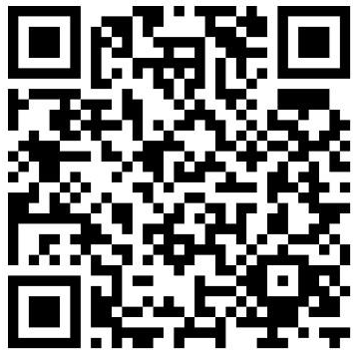
No more identity theft!
Harden your identity security today!
Per-Torben Sørensen
Technical architect @ Crayon

Slide 4
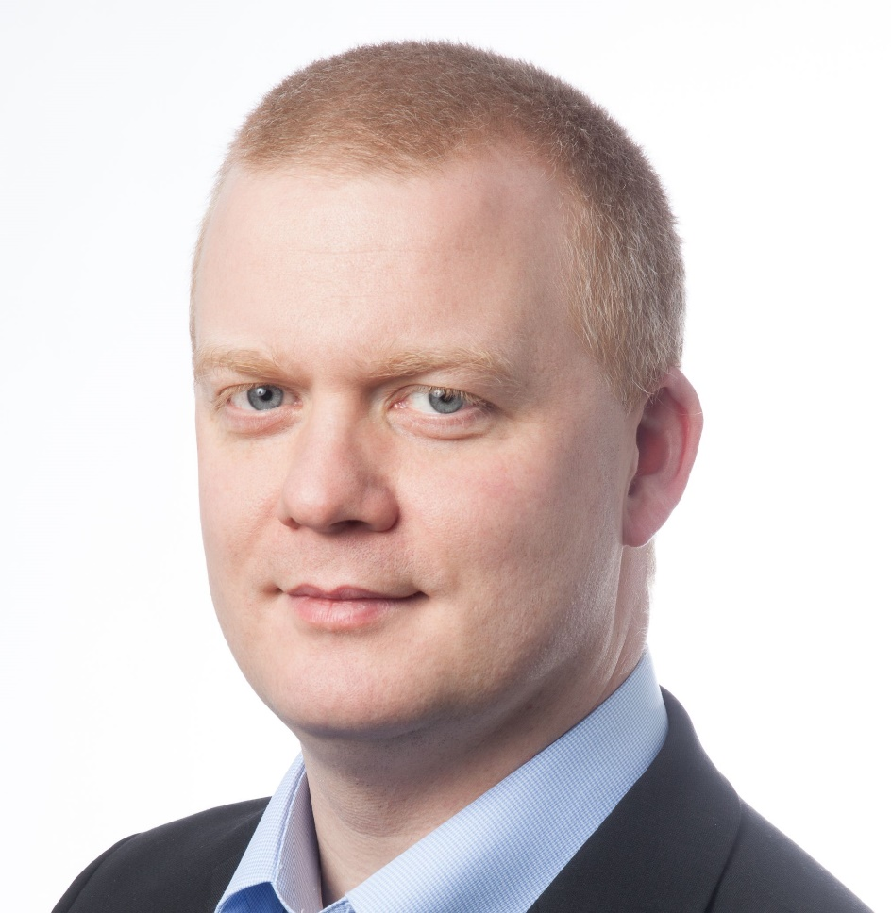
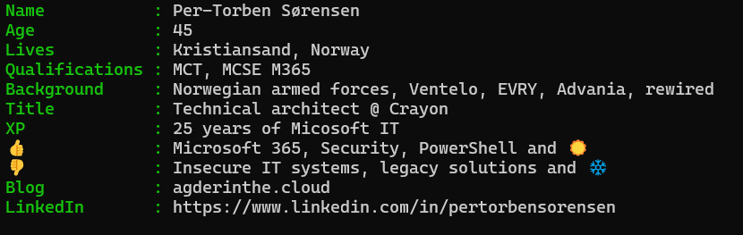
Hi there, hello!

Slide 5


Norway and Kenya ~6500 km apart
 | Norway | Kenya
Population | ~5,7 million | ~60 million
Area | 385k km2 | 582k km2
Capital | Oslo ~1,1 million | Nairobi ~5,5 million
Government | Monarchy | Republic
Length | From ~58° North to ~71° North (mainland) | From ~ 4,5° South to ~4,5° North

Slide 6
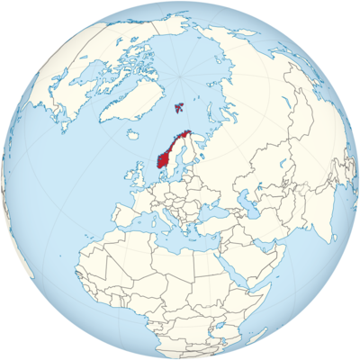
Where is Norway?

Slide 7
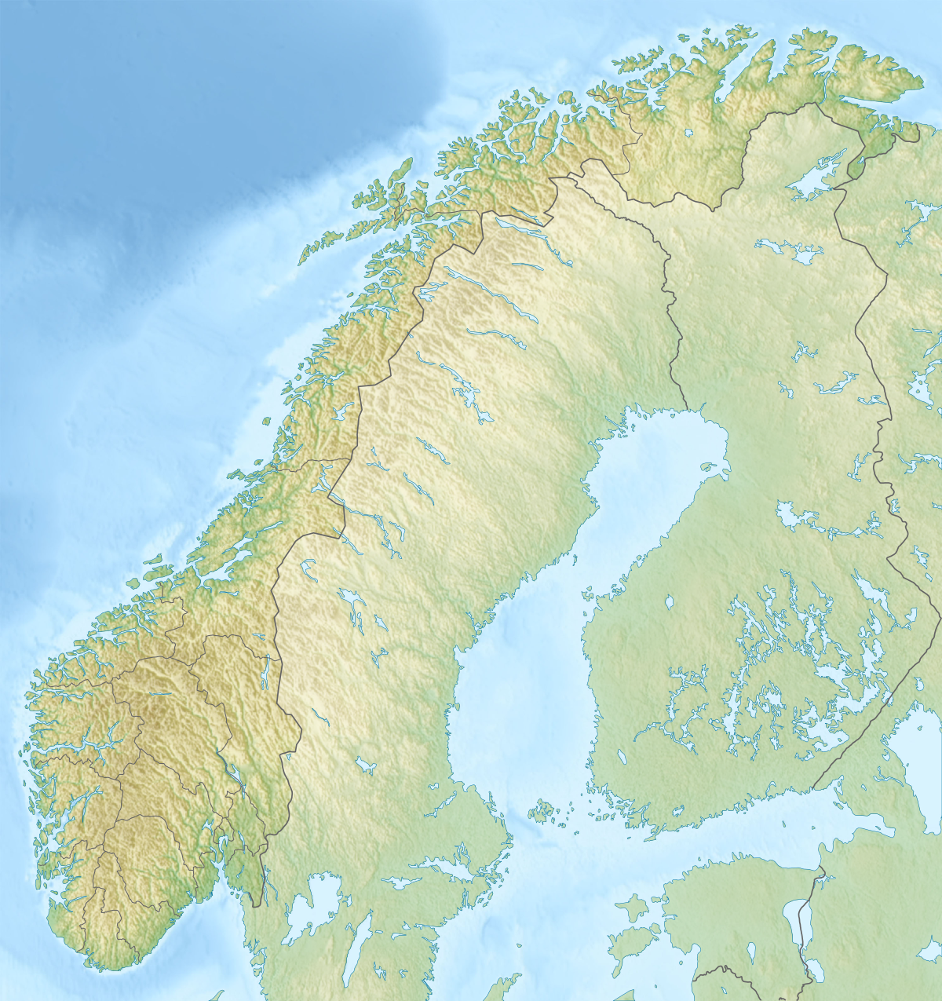

This is Norway
Notes:
You want to go NORTH of the arctic circle
Winter: Polar night
Summer: Midnight sun

Slide 8
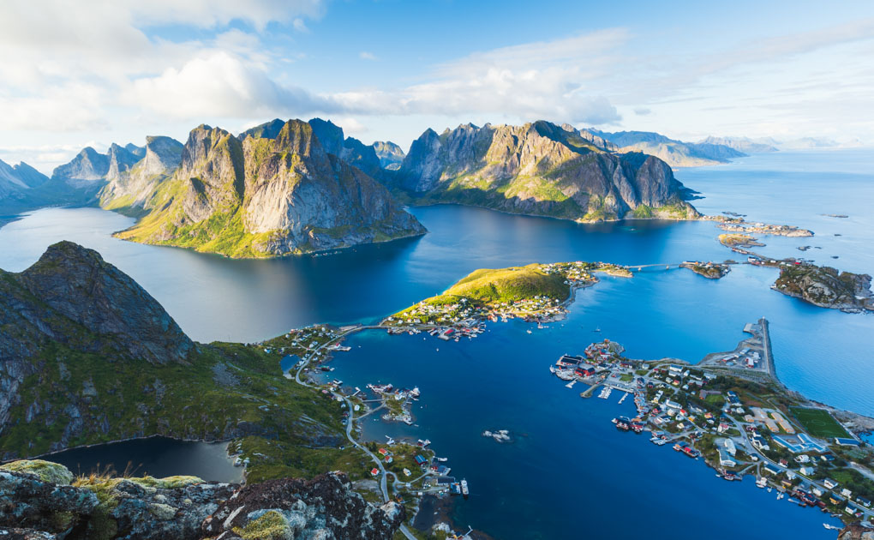
Norwegian summer

Slide 9
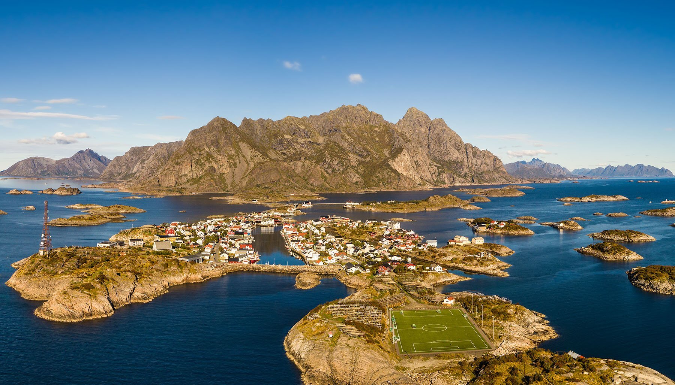
Norwegian summer

Slide 10
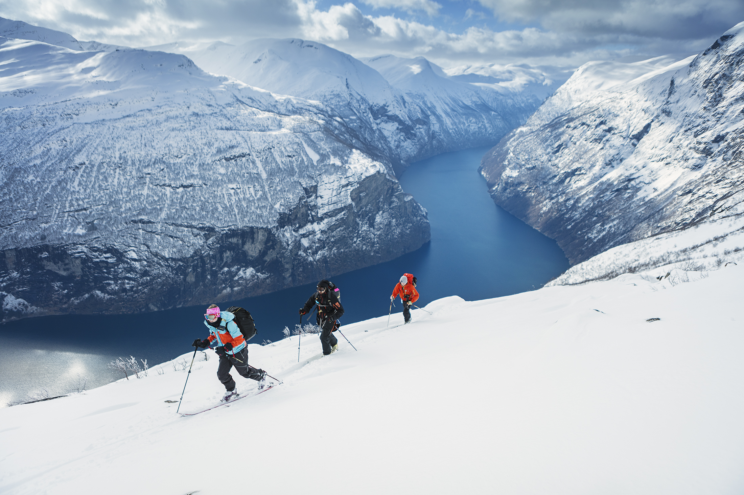
Norwegian winter

Slide 11
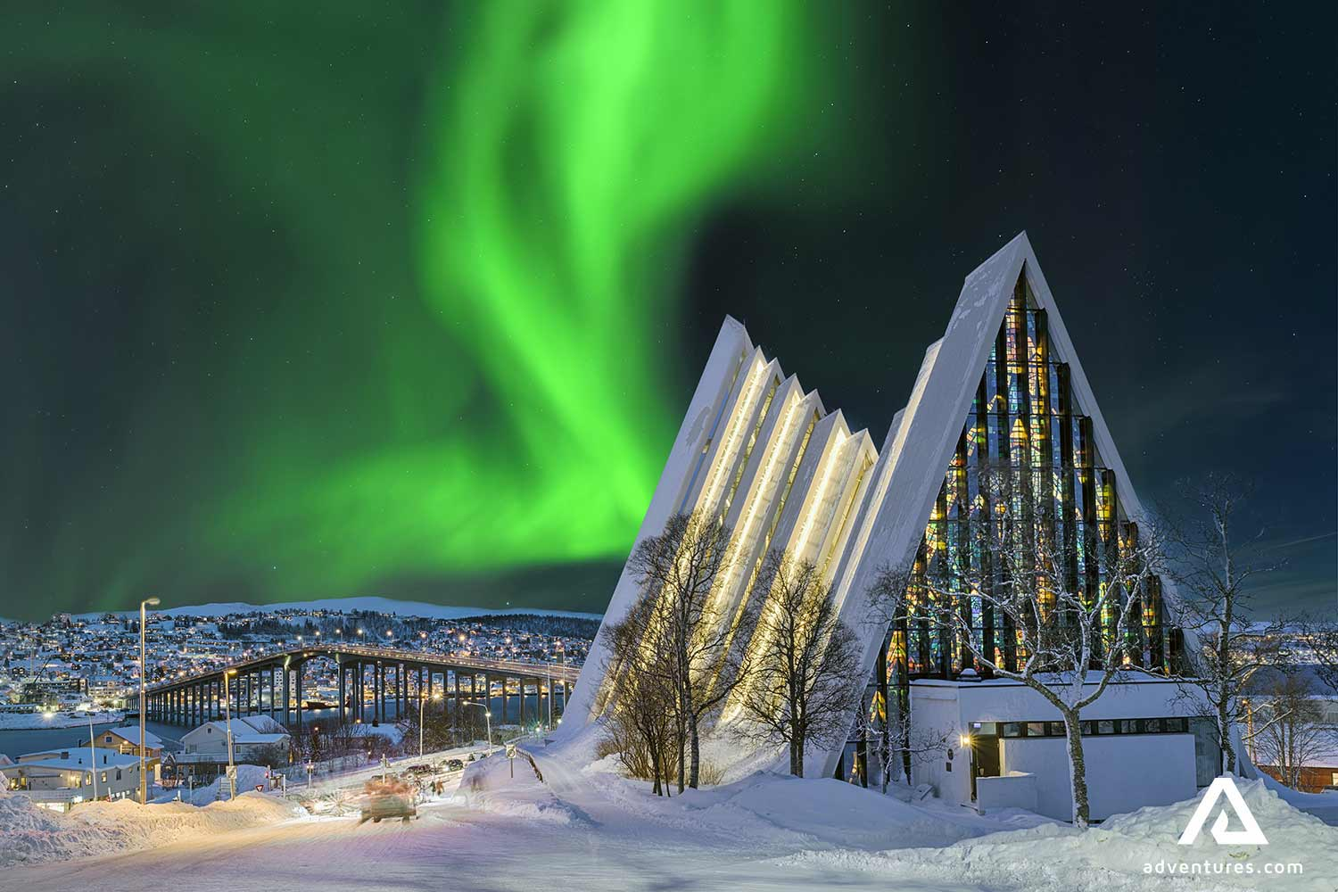
Norwegian winter
Notes:
Northern lights aka «aurora borealis»

Slide 12

Agenda
Introduction 😊
What the fuzz is about 📣 (MY experiences)
Conditional Access hardening 🧱
Passkeys 😍

Slide 13
What the fuzz is about
It’s about MFA (fatigue)

Slide 14
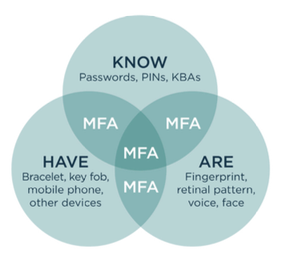
What is MFA (2FA)?
Multifactor authentication, to VERIFY your account.
3 Factors:
Something you KNOW
Password, PIN
Something you HAVE
Phone, USB-key
Something you ARE
Fingerprint, retinal scan
MFA = Use at least 2 of these 3 factors when you log in

Slide 15
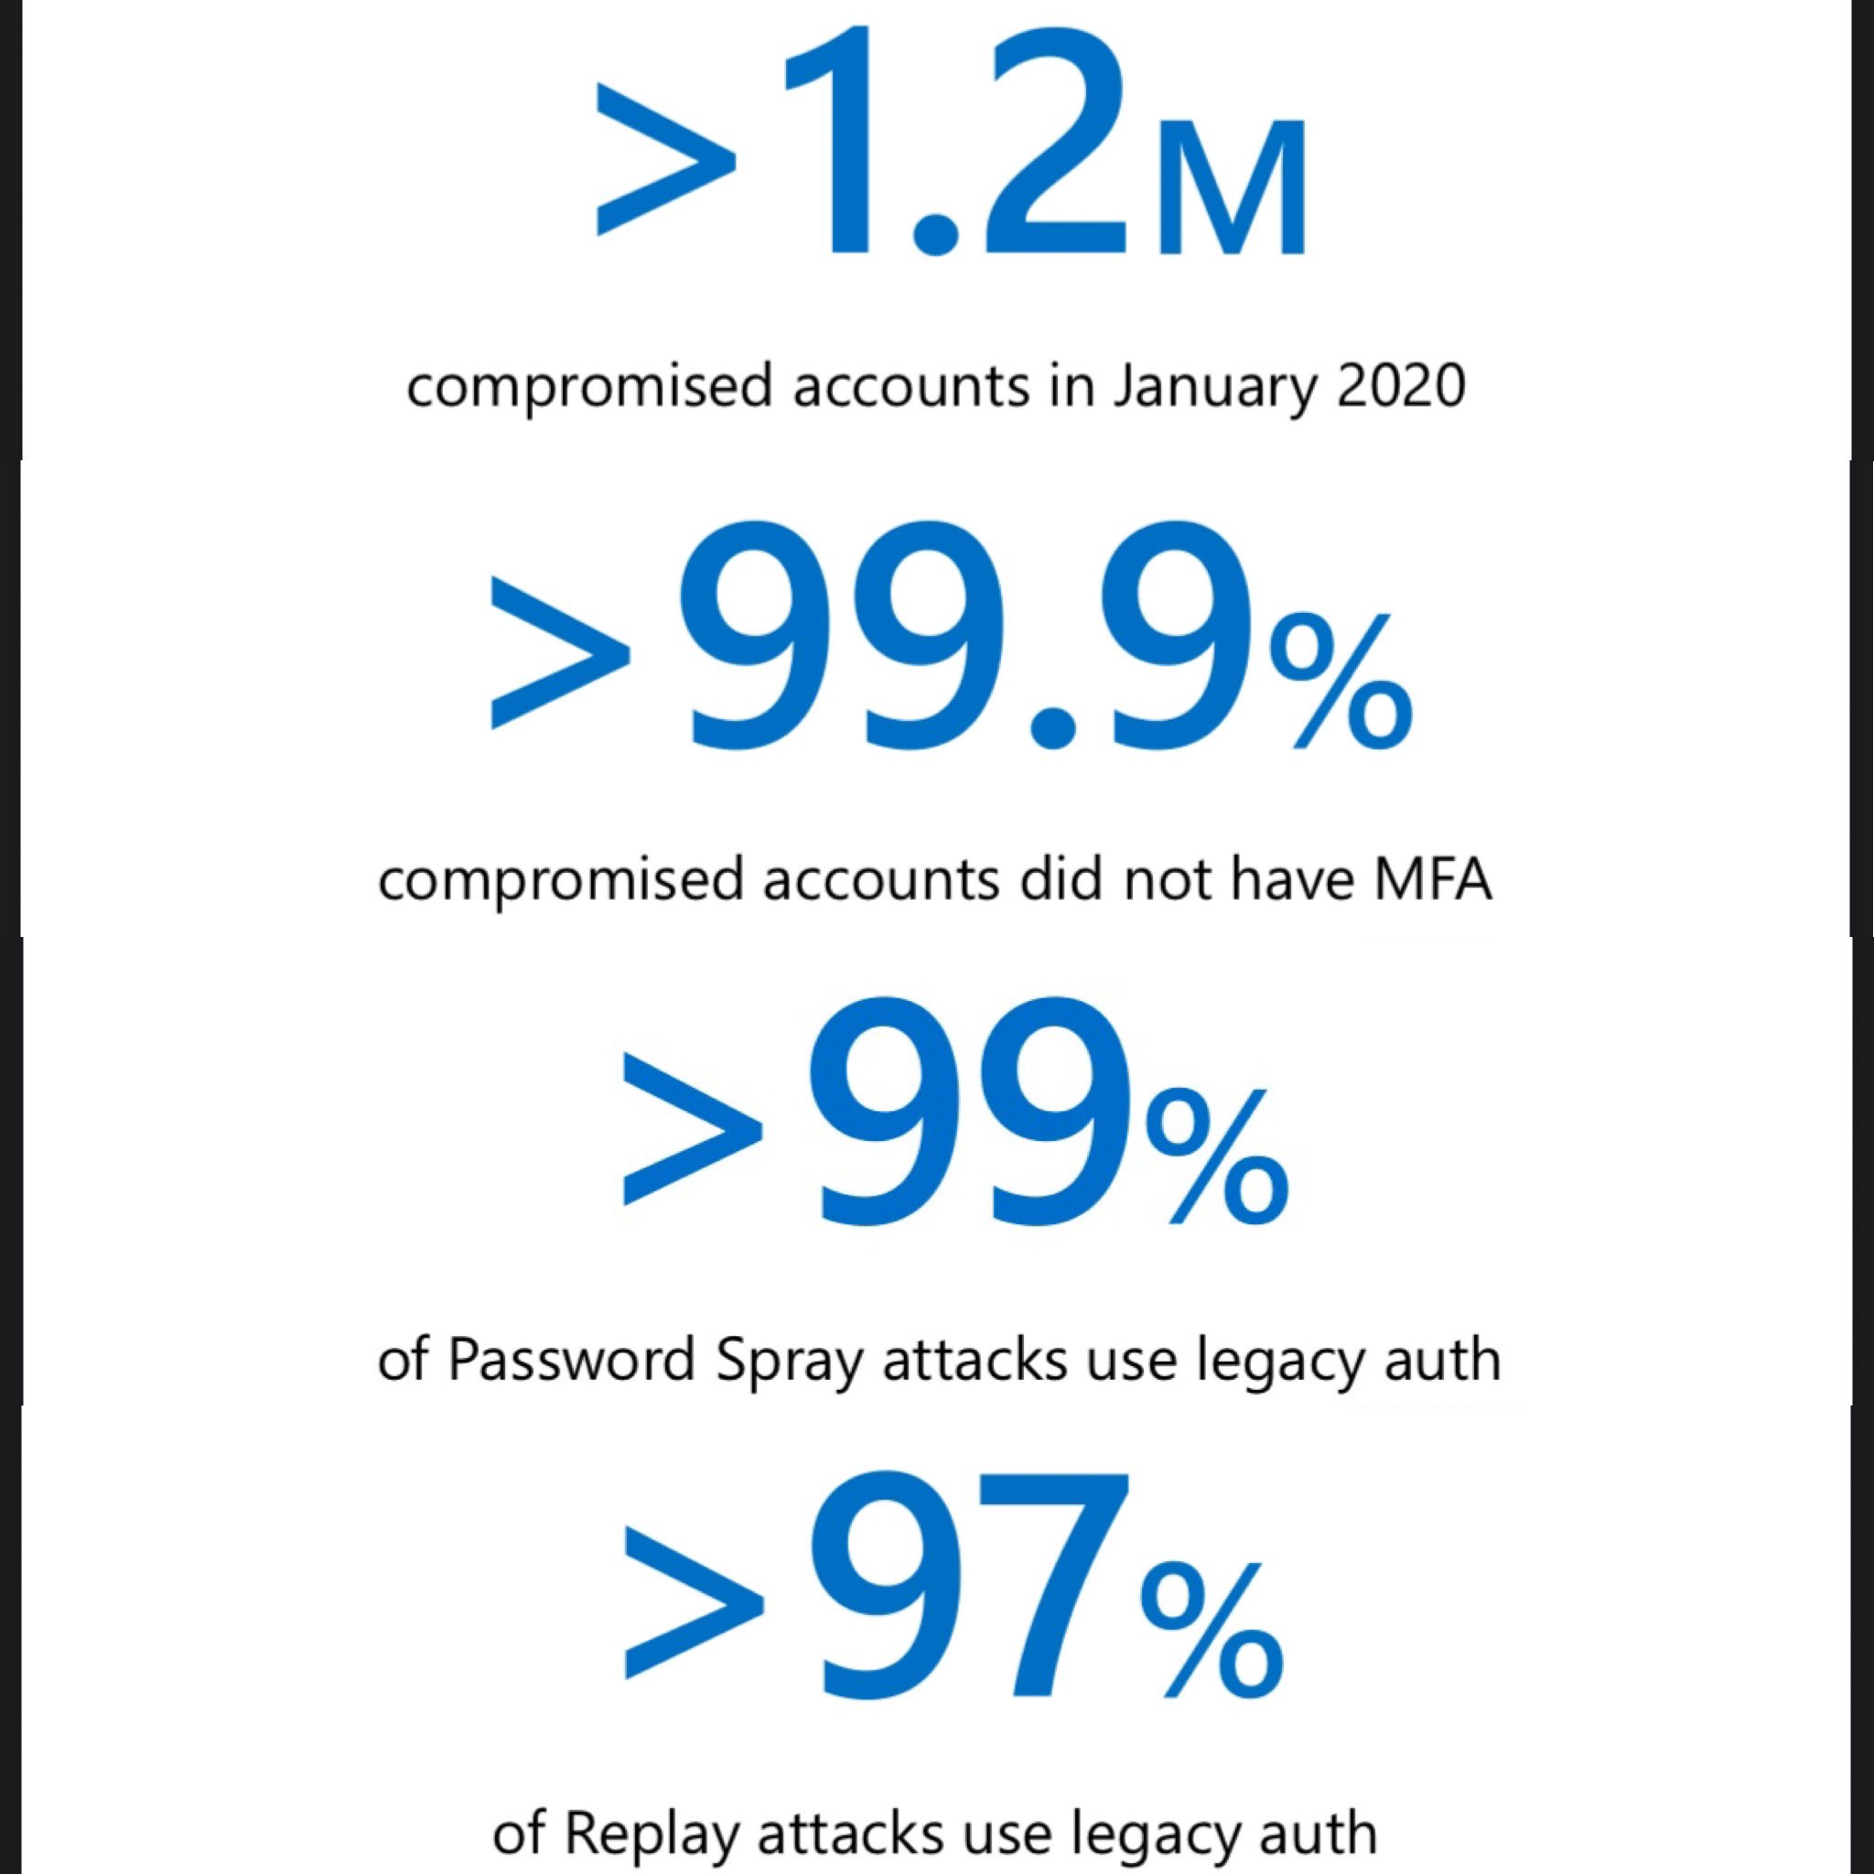
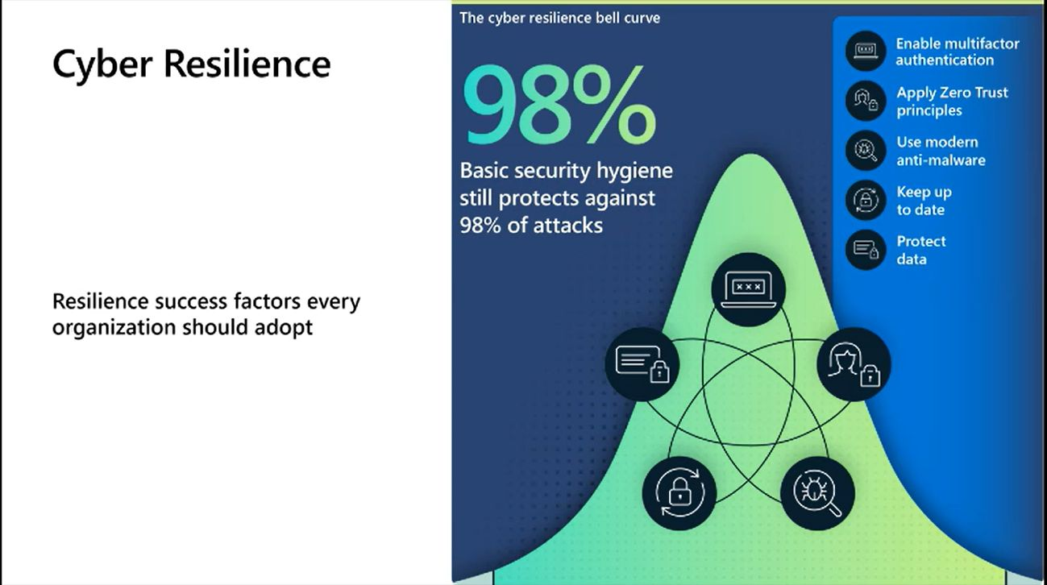
The problem: MFA fatigue
Notes:
Fatige not only in end-users, but also for IT admins

Slide 16

MFA fatigue, my experience
You’ve all heard this before… again and again and again and again….
But when I meet a new customer, their MFA coverage is always bad!
Identity security is the foundation of all security measures for SaaS solutions like M365
Many customers enable MFA through Conditional Access, but they don’t verify all accounts are protected.
Users are not asked to register MFA, until they log in AND is hit by an MFA requirement

Slide 17

Account hijacking
Accounts are particularly vulnerable before MFA is configured.
Don’t create (or sync) stale accounts.
Immediately secure new accounts when they are created (or synced).
2 MFA methods can be deployed with scripts:
SMS (But please don’t use it)
TAP (Temporary Access Pass)
Notes:
Remember the hijacked account, failed to configure MFA

Slide 18
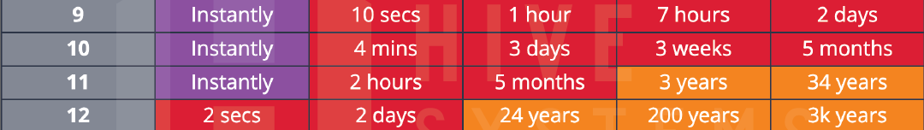
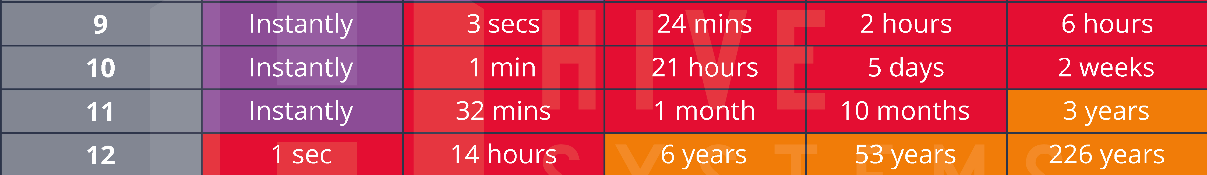
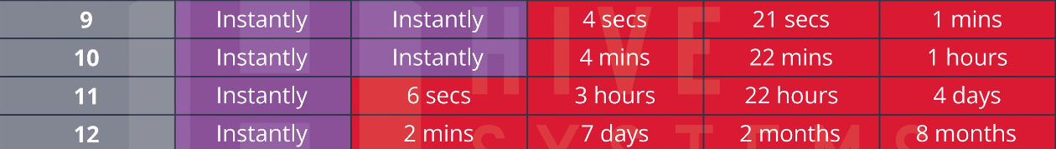
No need, we have complex passwords
2022
99,978%
2023
2023 (ChatGPT hardware)
Notes:
Hivesystems.io/passwords

Slide 19
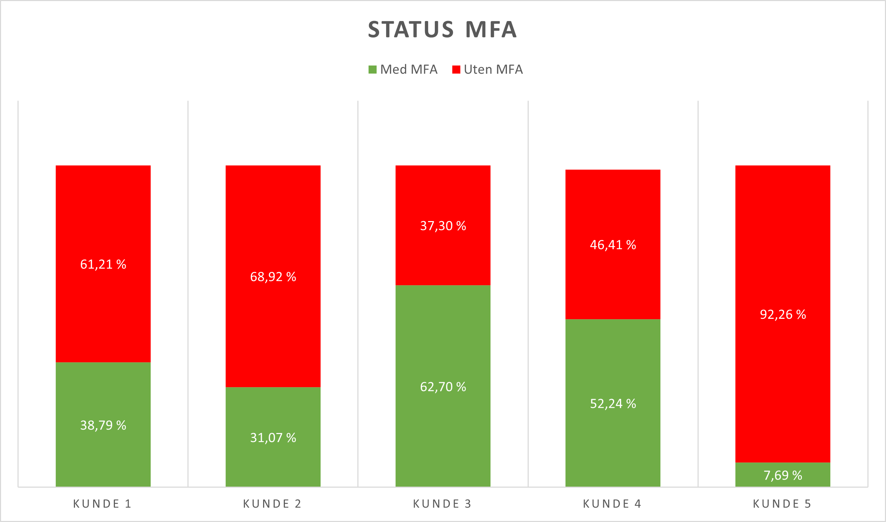





MFA adoption status
Random sample of 5 customers over 2 years.
Smallest ~700 accounts
Largest ~20000 accounts
Several reasons:
Poor scoping
“We don’t have critical data”
“It’s only for admins”
“Not in the office”

Slide 20
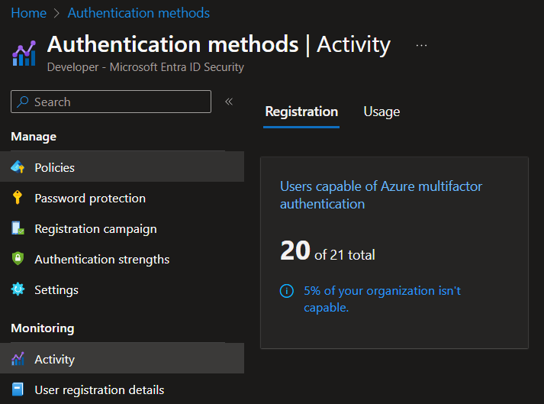
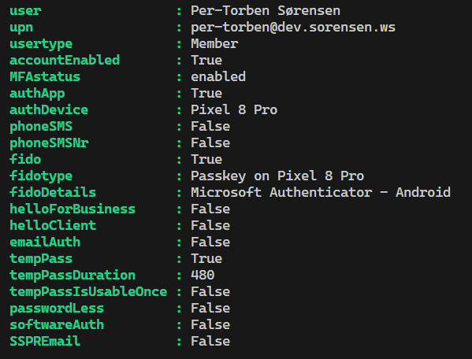
MFA adoption
Built-in report in Entra ID
Good old Powershell ❤️
Notes:
Script will be published on Agder in the cloud during August, stay tuned for a blogpost about it

Slide 21
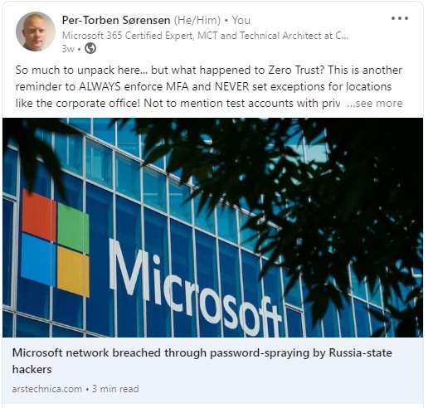
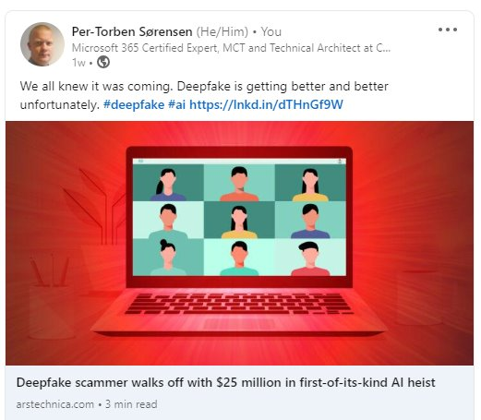
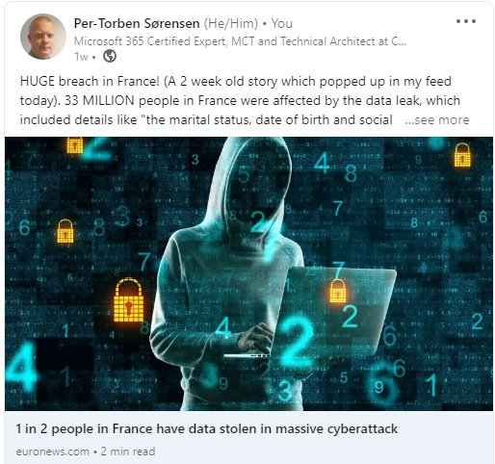
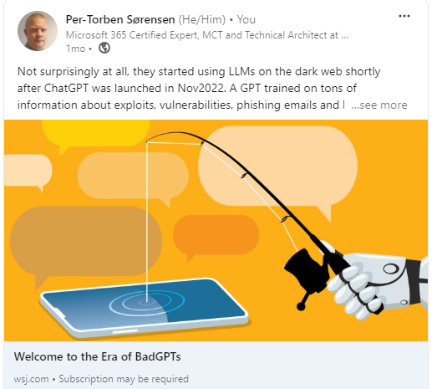
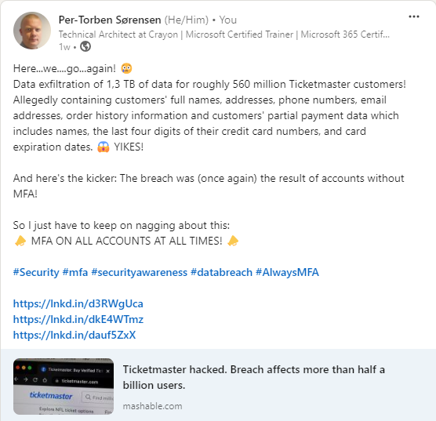
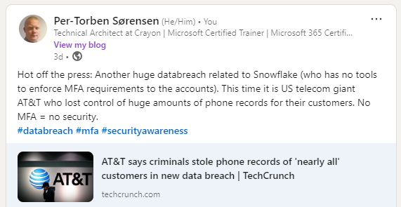
No MFA in 2024
Lesson learned
Guests and external accounts also need MFA!
Lesson learned
Test/demo accounts also need MFA!
Lesson learned (?)
MFA! MFA! MFA! MFA!
Lesson learned
We must VERIFY who’s logging on
Notes:
Microsoft: Test account without MFA, access to enterprise app with privileges
France: Extarnale healthcare worksers checking heatl insurance details
Marital status, date of birth, social security nr

Slide 22

Section conclusion
Identity security is the foundation of SaaS security
MFA must be enforced on ALL accounts
NO MFA = NO SECURITY
The bad actors only need 1 unprotected account…..

Slide 23
Agenda
Introduction 😊
What the fuzz is about 📣 (MY experiences)
Conditional Access hardening 🧱
Passkeys 😍

Slide 24

Raise your hands please
Is anyone in the audience unfamiliar with:
The fundamental features and principles of Entra ID Conditional Access?

Slide 25
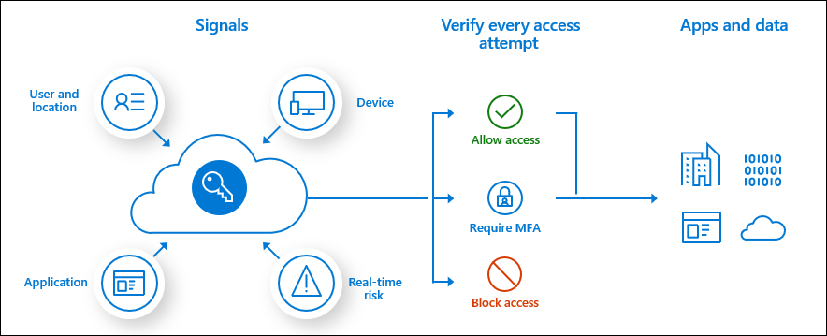
Conditional Access Policy (CAP)
Primary tool for Identity security in Entra ID
Evaluates every login based on a ruleset
Very flexible
Continuously improved and expanded
Requires Entra ID P1
P2 for additional features

Slide 26
DO:
DON’T:
Use CAP to enforce MFA on all accounts.
Establish a break-glass account
Explore and learn all capabilities in CAP to improve your security posture
Add additional security for privileged accounts
Use a naming standard
Use “Authentication Strength”, to block less secure methods
Exclude MFA for office networks!
“Set and forget”
Lock yourself out of your tenant
Implement changes without testing
Skip monitoring and rule backup
Forget to verify MFA adoption

Slide 27
The major flaw: 😱
Conditional access default behavior:
Log in allowed without any MFA
Unless anything else is specified, you can log in from anywhere, on any device, access any app, without any MFA!
Unless anything else is specified, you are blocked from logging in at all!

Slide 28
Conditional access hardening
Based on Microsoft's framework for Cond.access (Microsoft Learn)
Scaled down/adjusted to better fit companies who are not in the Enterprise-segment
It’s NOT a final solution
Always adapt to your evorinment/needs
Never just copy-paste
GOALS:
👍 Better naming standard
👍 Block login by default
👍 Systematically assign CAP for each persona
👍 Control which accounts can log in
Notes:
https://learn.microsoft.com/en-us/azure/architecture/guide/security/conditional-access-framework

Slide 29
Persona and naming standard
Numbering and personas example:
00 = Global (all accounts)
01 = Admins (privileged accounts)
02 = Users (user accounts)
03 = Svc (service accounts)
04 = Guests (guest accounts)
University example:
00 = Global (all accounts)
01 = Admins (privileged accounts)
02 = Users (user accounts)
03 = Faculty (faculty accounts)
04 = Students (student accounts)
05 = Research (research accounts)
06 = Guests (guest accounts)
07 = Svc (service accounts)
Naming standard:
CA(Personanr.) – (Seq.nr) – (Persona) – (Target) – (Requirement)
Examples:
“CA01 – 00 – Admins – Baseline – Req.MFA”
“CA02 – 03 – Users – Visma – Req.CompliantDevice”
Notes:
IF this sounds like a lot of planning on paper – it is! And it must be
Put in the time and effort, it pays off

Slide 30
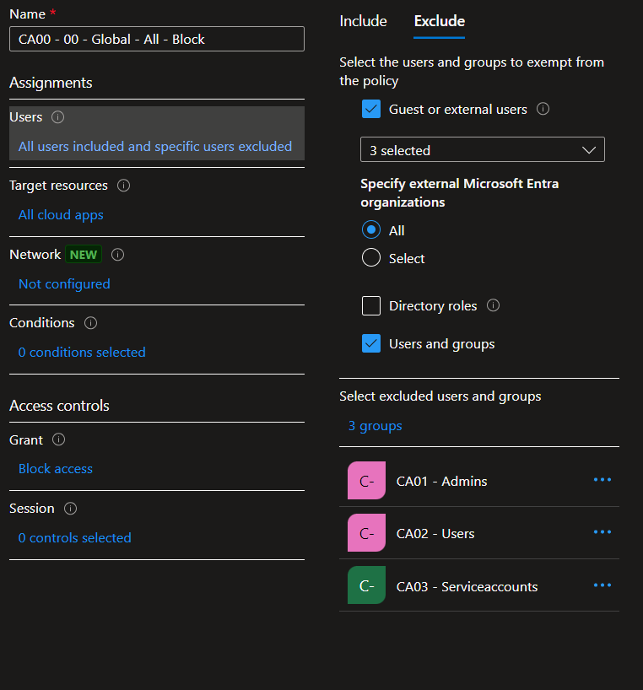
Block login by default
“CA00 – 00 – Global – All – Block”
Scoped to:
All users (excluding allowed users)
All cloud apps
Block access
Only the exclude list can log in
Guests
Members of groups
CA01
CA02
CA03

Slide 31
Systematically assign CAP
Baseline config pr persona
“CA01 – 00 – Admins – Baseline – Req.MFA”
“CA02 – 00 – Users – Baseline – Req.MFA”
“CA03 – 00 – SvcAccounts – Baseline – Req.OfficeNetwork”
“CA04 – 00 – Guests – Baseline – Req.MFA”
“Baseline” = Minimum protection
Use additional rules to add/customize protection
This setup prevents logins without CAP applied

Slide 32
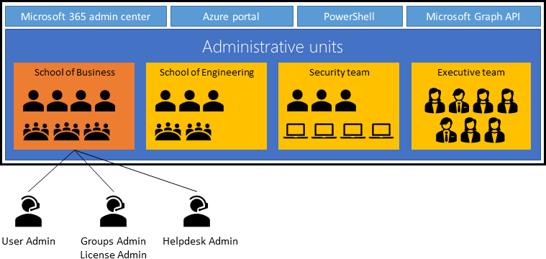
Control which accounts can log in
Entra ID Administrative Unit (AU)
Delegation of admin rights in Entra ID
Target specific (add to AU)
Users
Groups
Devices
Delegate certain roles to specific users
Aka “AU-Delegates”
They only have admin rights within the AU
Other privileged users have admin access to all AUs
Notes:
Picture: Microsoft Learn
AU can also be used to scope various compliance policies

Slide 33
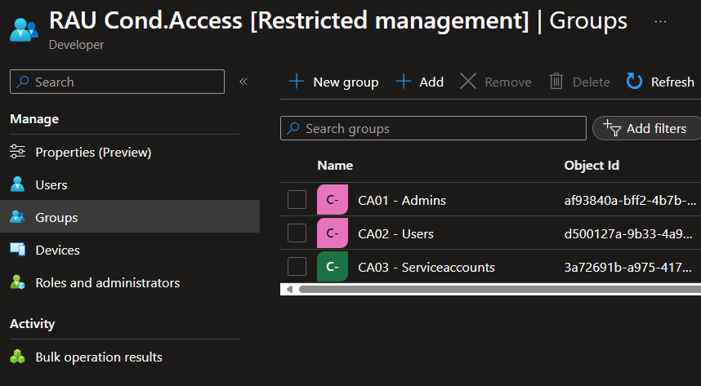
Control which accounts can log in
Entra ID Restricted management AU
A restricted AU blocks privileged access from other admins in the tenant
Only the AU-delegates has privileged access
We will:
Add the CA-groups into the Restricted AU
Delegate “Groups administrator” role to specific users
No one else can change group membership, prevents lateral movement
This effectively locks down the ability to grant log on rights, to specific people in your tenant.

Slide 34





An overview
Restricted AU - Groups Administrators
CA01- 00 - Admins…
CA01- 01 - Admins…
CA01- 02 - Admins…
CA01 - Admins
CA02- 00 – Users…
CA02- 01 – Users…
CA02- 02 – Users…
CA02 - Users
CA03- 00 – SvcAccounts…
CA03- 01 – SvcAccounts…
CA03- 02 – SvcAccounts…
CA03 - SvcAccounts
Restricted Admin Unit
Conditional Access Policies

Slide 35
DEMO! Cond.Access hardening!

Slide 36
Delegate with care!
Can change Conditional Access settings:
Conditional Access Administrator
Security Administrator
Global Administrator
Can change or delete Restricted AU:
Privileged Role Administrator
Global Administrator
Can change/reset password and MFA on all accounts (including Global Admins):
Privileged Authentication Administrator
Global Administrator
Back up your Cond.Access rules!
Monitor and set up alerts for changes in:
Cond.Access rules
Restricted AU

Slide 37
Section conclusion
Change Conditional Access to block-by-default
Adapt CAP to your organization and its needs
A good naming standard is important
Back up your CA policies
Monitoring and alert is vital!

Slide 38
Agenda
Introduction 😊
What the fuzz is about 📣 (MY experiences)
Conditional Access hardening 🧱
Passkeys 😍

Slide 39
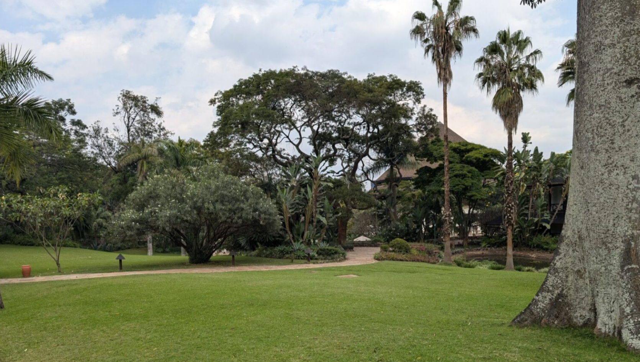
Winter in Kenya
Notes:
Looks like a nice winter

Slide 40
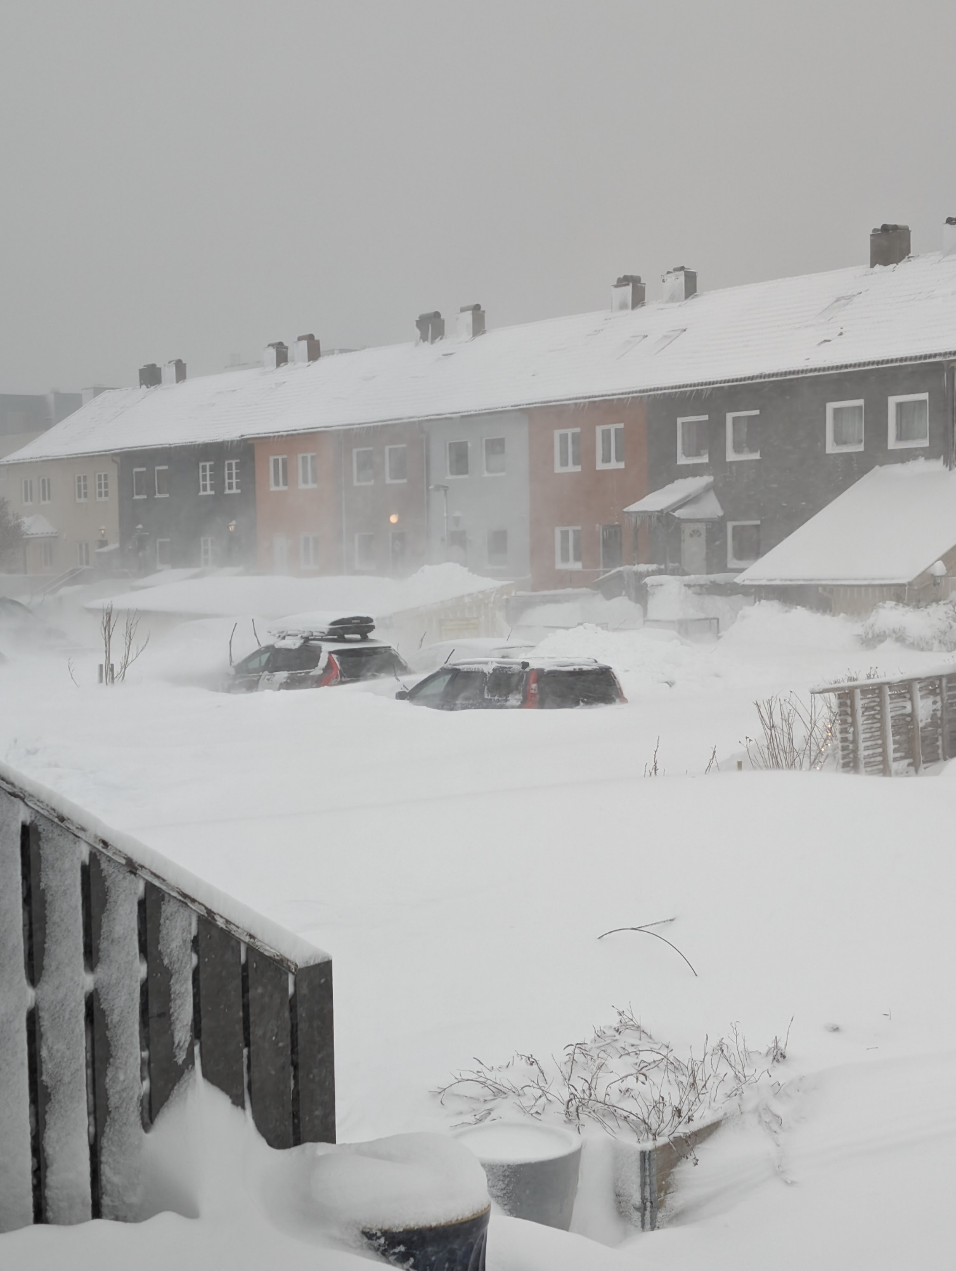
6 months ago..

Slide 41
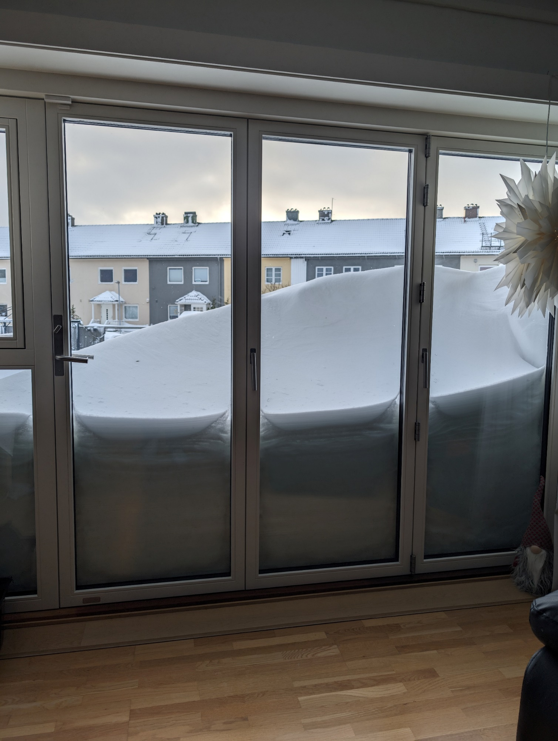
6 months ago..

Slide 42
6 months ago..

Slide 43
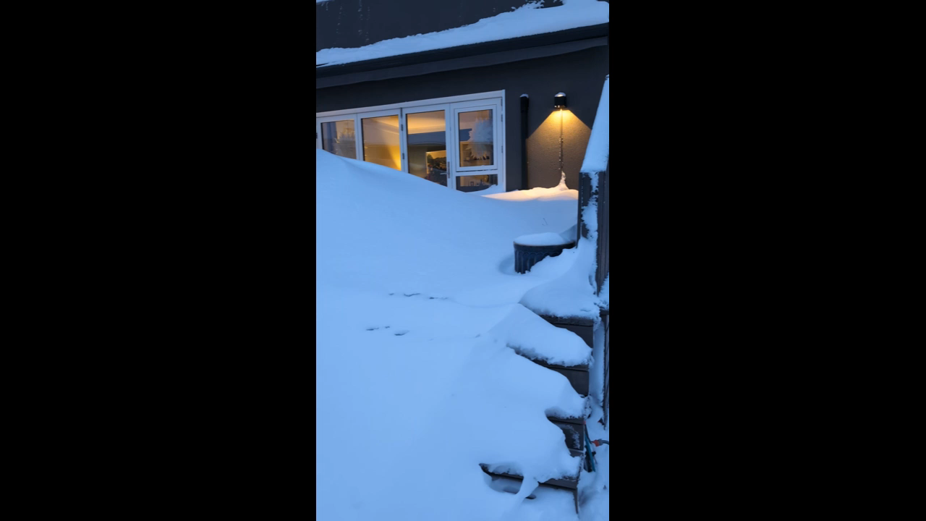
6 months ago..

Slide 44
Raise your hands please
Is anyone in the audience unfamiliar with:
The fundamental features and principles of
Asymmetric keys (private/public keys)

Slide 45
Asymmetric keys, introduction
The problem:
How do we encrypt/sign data without any pre-shared knowledge?
The solution:
We use math.
The system generates two mathematical “keys” based on very large
prime numbers.

Slide 46
Asymmetric keys, introduction
Asymmetric encryption uses a keypair:
A public key and a private key.
Globally unique
Public key is shared – Private key stays with owner, always hidden
If data is encrypted/signed with public key:
The same public key can NOT decrypt/verify ❌
Only private key can decrypt/verify ✅
If data is encrypted/signed with private key:
The same private key can NOT decrypt/verify ❌
Only public key can decrypt/verify ✅

Slide 47

Passkeys
Passwordless authentication 🥳
From the FIDO2 alliance
Built from the ground-up
Easier than passwords
More secure than passwords
Based on PKI (Asymmetrical keypairs)
Activated by PIN or biometrics
Communicates over “webauthn”
First: Generic passkeys

Slide 48
Passkey creation
Login with MFA
Public key
Created and stored LOCALLY
Domain-bound
A copy is transmitted to the cloud service
Private key
Created and stored LOCALLY
NEVER exposed
Inactive

Slide 49

Passkey login
User wants to log in:
Client sends an authentication request
Includes public key
The cloudservice:
Check the public key
Generates a random challenge
Signs it with the public key
Transmits it to the client with a credential ID
The user:
verifies his/her identity locally with PIN/biometric
Activates the private key
The client:
Verifies the signature using the private key
Signs the challenge with the private key
Returns it with username and cred.ID
Only valid once
The cloudservice:
Verifies the signature
Checks cred.ID
provides session token

Slide 50
DEMO! Passkeys (Github)

Slide 51
Why are passkeys better?
NO PASSWORDS over the network!
Cross-platform
Works with all major devices and browsers
Domain-bound public key
Phishing site resistant
Local authentication
Man-in-the-middle resistant
Signed response only works once
Replay attack resistant
Very user friendly

Slide 52
Passkeys in Entra ID (preview)
👍 Public preview since April 2024
👍 Easier and more secure than traditional password+MFA push
👎 Not as user friendly as regular passkeys
👎 MS requires you to store the passkeys in Microsoft Authenticator app
Android 14 / iOS 17
A major disadvantage for users without mobile phones.
For example: Elementary school students and healthcare workers

Slide 53
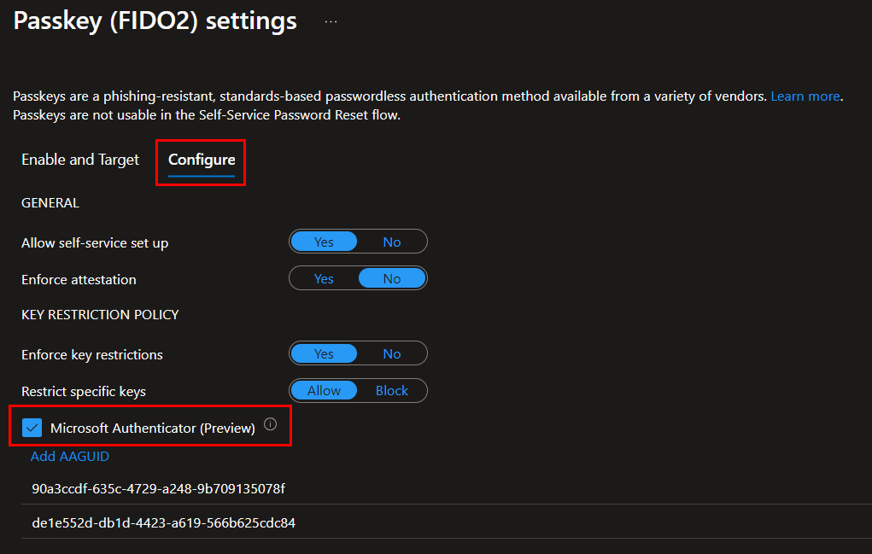
Passkeys in Entra ID (preview)
Admins:
Enable passkeys in the tenant:
Authentication methods
Passkey (FIDO2) settings
Configure
Remember:
The end-user needs at least one MFA method to register a passkey

Slide 54
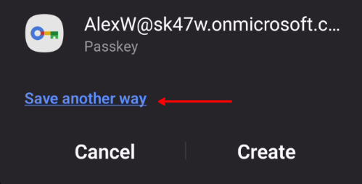
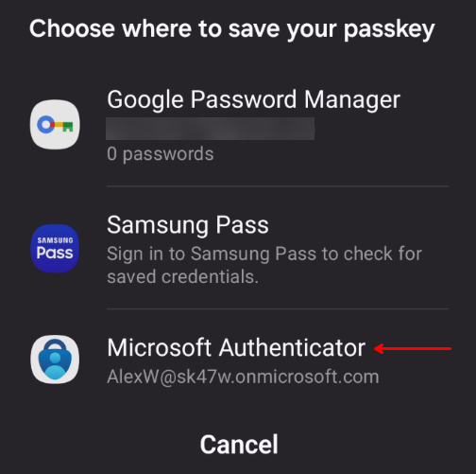
Passkeys in Entra ID (preview)
End-user:
Sign in to https://aka.ms/mfasetup
Click “Add sign-in method”
Select “Passkey in Microsoft Authenticator (preview)”
Follow the wizard
Select device
Important to select “Microsoft Authenticator” to save the passkey

Slide 55
DEMO! Passkeys (Entra ID)

Slide 56
Section conclusion
Passkeys are low-cost and highly secure
Very user friendly
Passkeys in Entra ID requires Authenticator app
Start testing today! This a MAJOR feature!

Slide 57

Asante, Afrika ❤️
If you want to go fast, go alone.
If you want to go far, go together!

Slide 58

Session Feedback
Session Track:
Security
Session Name:
No more identity theft!
Harden your identity security today

Slide 59
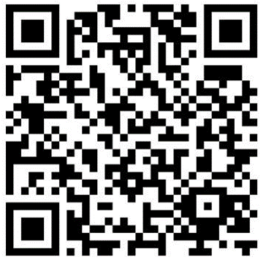
THANK YOU
Per-Torben Sørensen
Technical architect @ Crayon
Linkedin:

Slide 60









THANK YOU TO OUR SPONSORS!

